Slide 1
Live Danger Map
Team R139

Slide 2
Where am I safe?
In times of crisis and war, civilians abroad face chaos, fear, and unreliable information. Their most urgent question?

Slide 3
An embassy-hosted crisis map
Real-time safety shouldn't be a guessing game. Our answer?

Slide 4
Safety First
Accessibility
Protection of Civilians
Available to anyone
Trustworthy Information
Official embassy and government sources
Ease of Use
Real-Time Awareness
Intuitive design
Live data

Slide 5
Demo

Slide 6
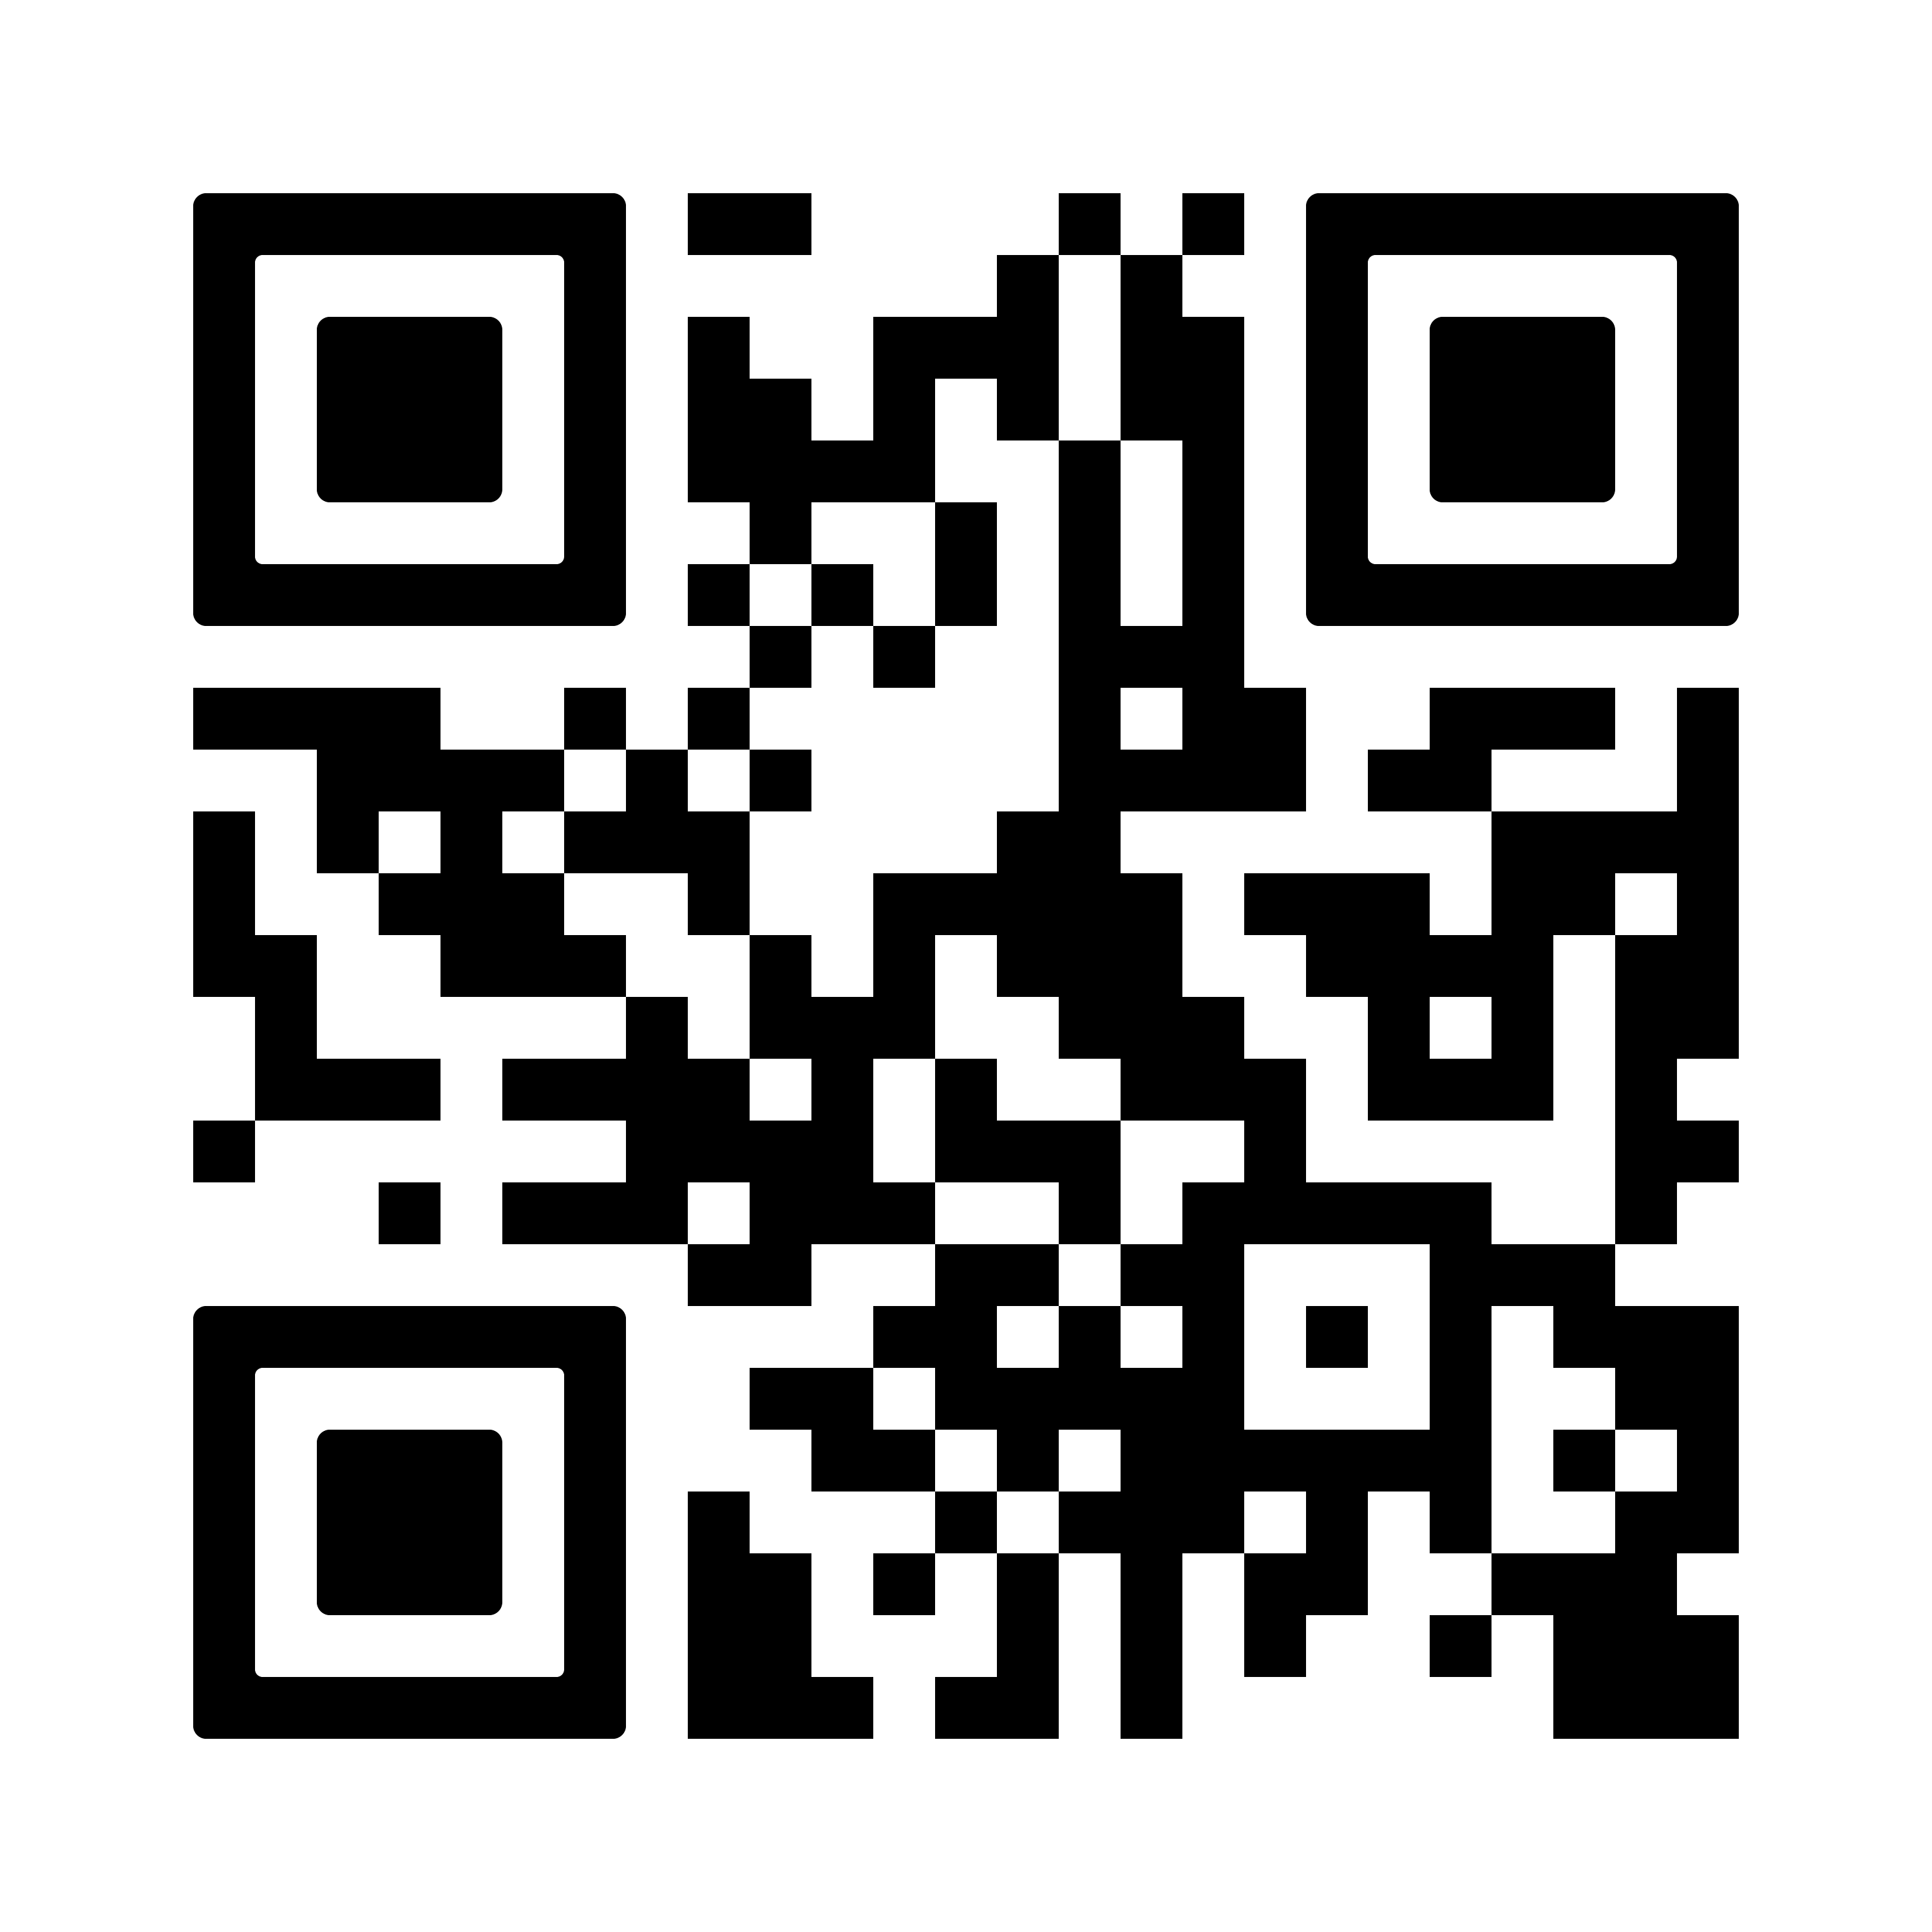
Thanks!
Feel free to check out the project!

